Slide 1
World Canals Timeline
4000 BC 1681 1845 1914
610 BC 1790 1869 2015

Slide 2
Match Canals with Timeline Dates
Augusta Canal
Suez Canal
Hangzhou Grand Canal
Canal du Midi
Babylonian Canals
Panama Canal
Beginning of the American Canal Era

Slide 3
World Canals Timeline
4000 BC 1681 1845 1914
610 BC 1790 1869 2015

Slide 4
World Canals Timeline
4000 BC 1681 1845 1914
Babylonians Canal Du Midi Augusta Canal Panama Canal
Hangzhou US Canal Era Suez Panama Expan. 610 BC 1790 1869 2015

Slide 5
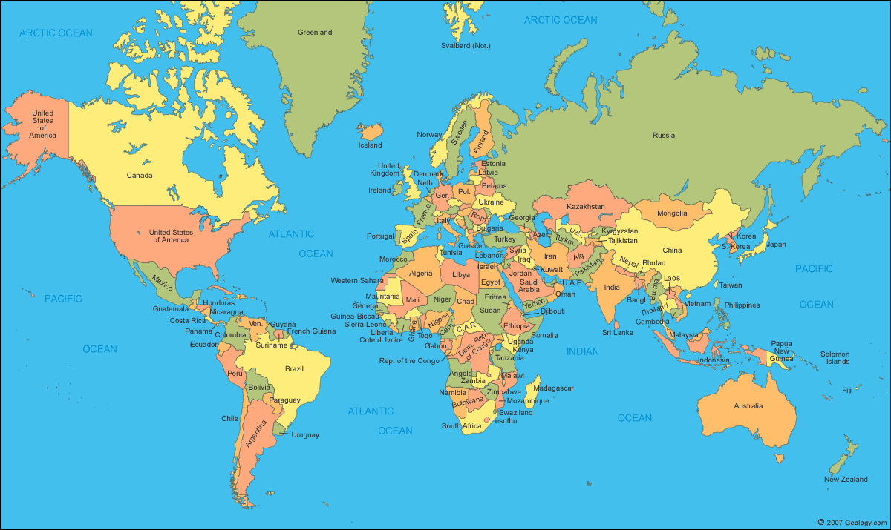
Name These 5 Canals
3
1
5
4
2

Slide 6
Name These 5 Canals
3 Canal Du Midi
(Southern France)
1 Augusta
Canal (GA-US)
4
Suez Canal
Egypt
5Hangzhou
Grand Canal
Panama 2
Canal
(Central America)

